Slide 1
RISKAC
ELECTRONICS PROJECT

Slide 2
Theoretical Project Design and Research

Slide 3
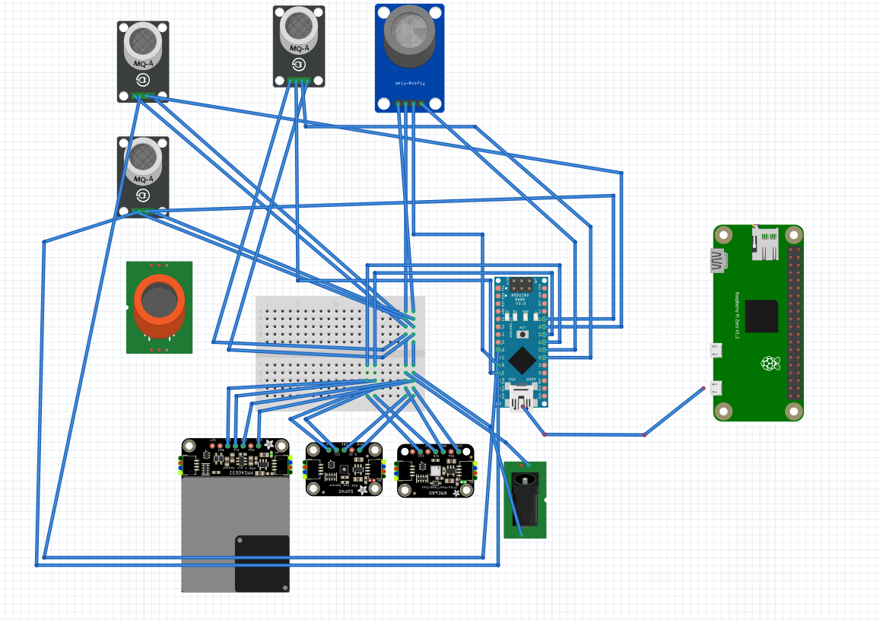
INDOOR SETUP(1)

Slide 4
INDOOR SETUP(2)
Indoor Sensor | Applications | Protocol
PMSA003I | Either indoors or outdoors with protecting cover | I2C & UART
MCP9808 | General purpose – high precision sensor | I2C & SPI
BMP180 | Barometric pressure and temperature | I2C
MQ2 MQ-2 | Domestic and industrial applications , detection of. LPG, propane and H2 | 2 Vcc, A0, Trans
MQ4 | Domestic and industrial applications CH4 detection | 2 Vcc, A0, Trans & 1 Dig.
MQ131 | Domestic, O2 detection | 2 Vcc, A0, Trans & 1 Dig.
MQ7 MQ-7 | Domestic applications, CO detection (toxic) | 2 Vcc, A0, Trans & 1 Dig.

Slide 5
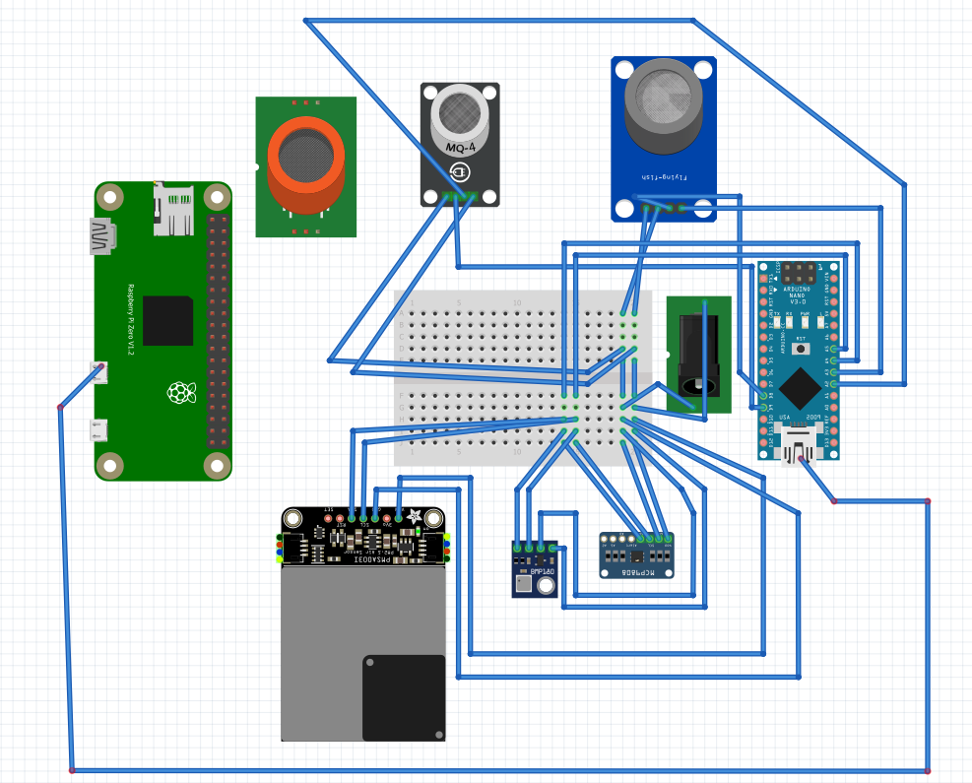
OUTDOOR SETUP (1)

Slide 6
OUTDOOR SETUP (2)
Sensor | Applications | Protocol
BME680 | Domestic applications | I2C & SPI
PMSA003I | Indoors and outdoors with protecting cover | I2C & UART
MH-Z19 | Domestic applications CO2 | UART / Analog
MQ8 | Domestic and industriial applications H2 detection | 2 Vcc, A0 Trans. , 1 Dig.
Adafruit SGP40 | Domestic indoor applications, & outdoors VOC detection | I2C
ZE08-CH2O | Indoors and outdoor applicationsFormadehyde detection | UART
MQ2 MQ-2 | Domestic and industrial applications, LPG, detection H2 and propane | 2 Vcc, A0, Trans & 1 Dig.
MQ4 | Domestic and industrial applications, CH4 detection | 2 Vcc, A0, Trans & 1 Dig.
MQ7 MQ-7 | Domestic applications and portable devices, CO detection (toxic) | 2 Vcc, A0, Trans & 1 Dig.

Slide 7
Anemometer Setup (1)

Slide 8
Anemometer Setup (2)
Material | Protocol | Purpose | Details
Davis Anemometer | - 1 analog for direction - 1 digital for speed | Anemometer | Supply 5[VDC] , adapter and mounting bracket
RJ11 Breakout - Creatron Inc | - | Adapter | For the anemometer
Anemometer Mounting Base | - | Mounting bracket | For the anemometer
RG-11 Optical Rain Gauge | 1 Digital pin | Rain gauge | Supply 12[VDC]
Adafruit BME680 | I2C & SPI | Temperature, gases and humidity | For indoor and outdoor applications

Slide 9
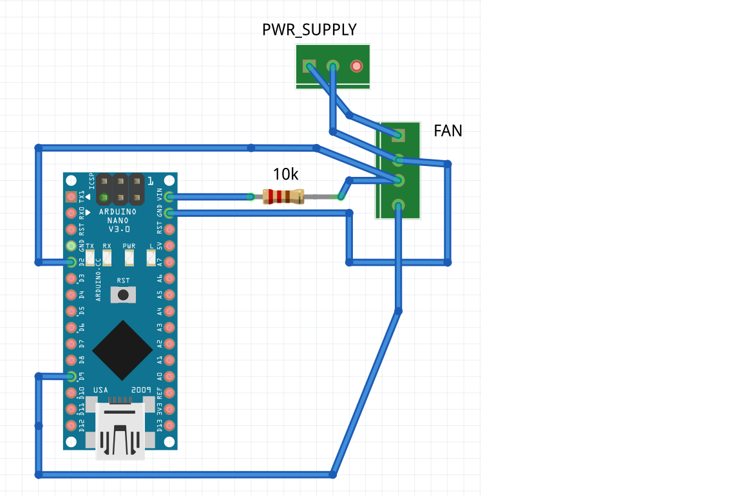
FANS SETUP
2 & 3 : Pins suitable for interrupt
2 & 3 : INPUT_PULLUP command (optional) 5,6,9,10,11 : suitable for PWM control
5,6,9,10,11 : mapped value

Slide 10
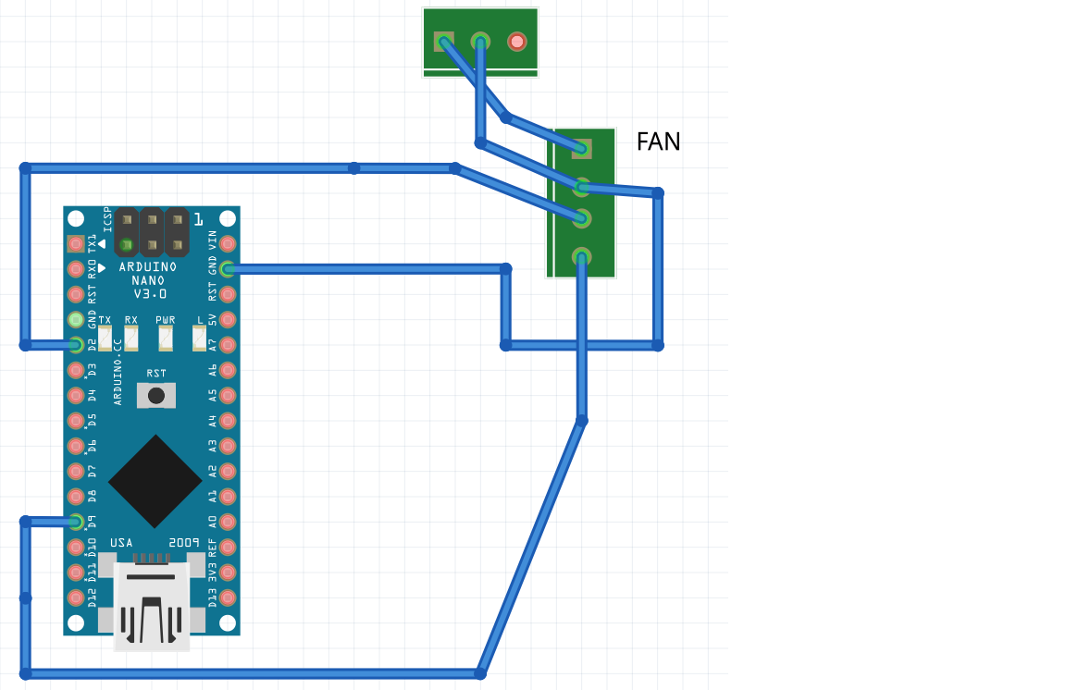
FANS SETUP with INPUT_PULLUP
2 & 3 : Pins suitable for interrupt
2 & 3 : INPUT_PULLUP command (optional) 5,6,9,10,11 : suitable for PWM control
5,6,9,10,11 : mapped value

Slide 11
PCB Design and Components

Slide 12
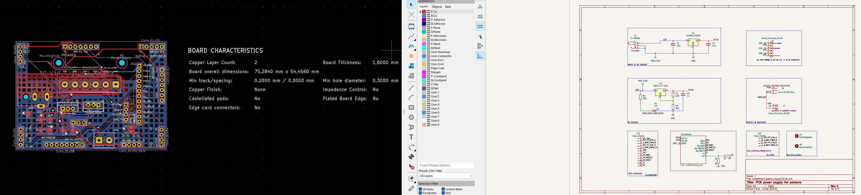
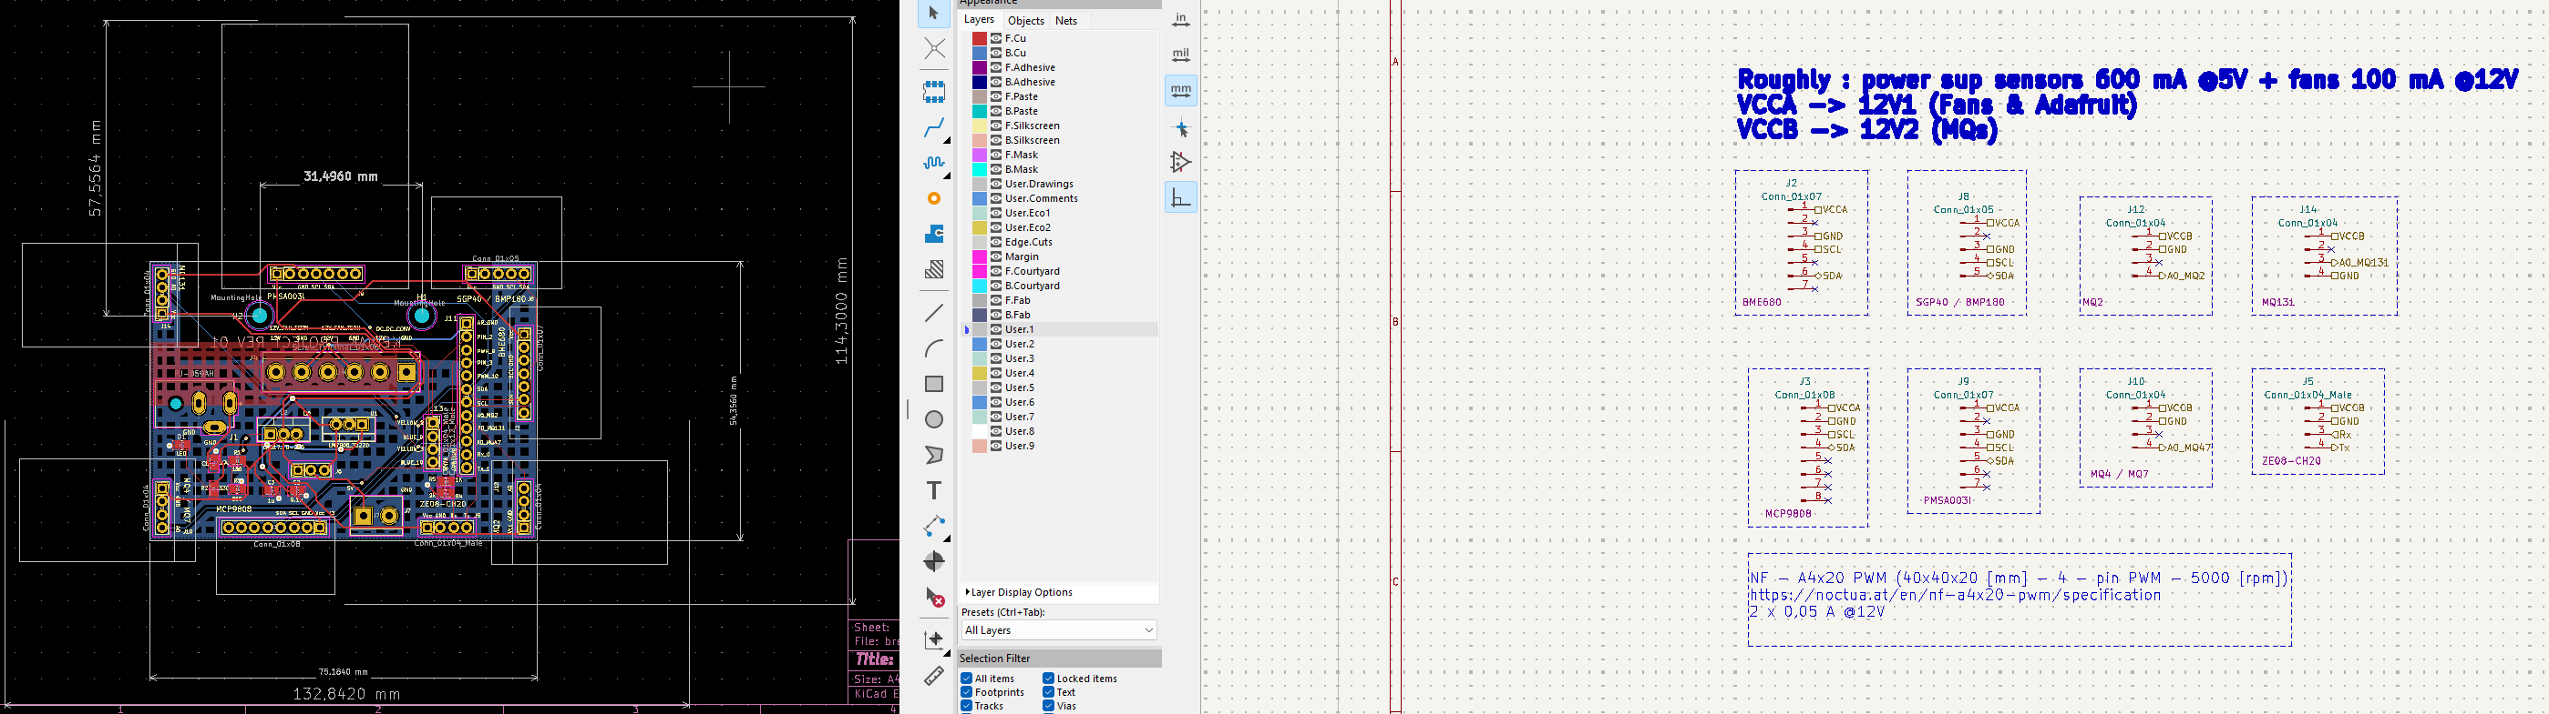
Custom PCB Design (1)

Slide 13
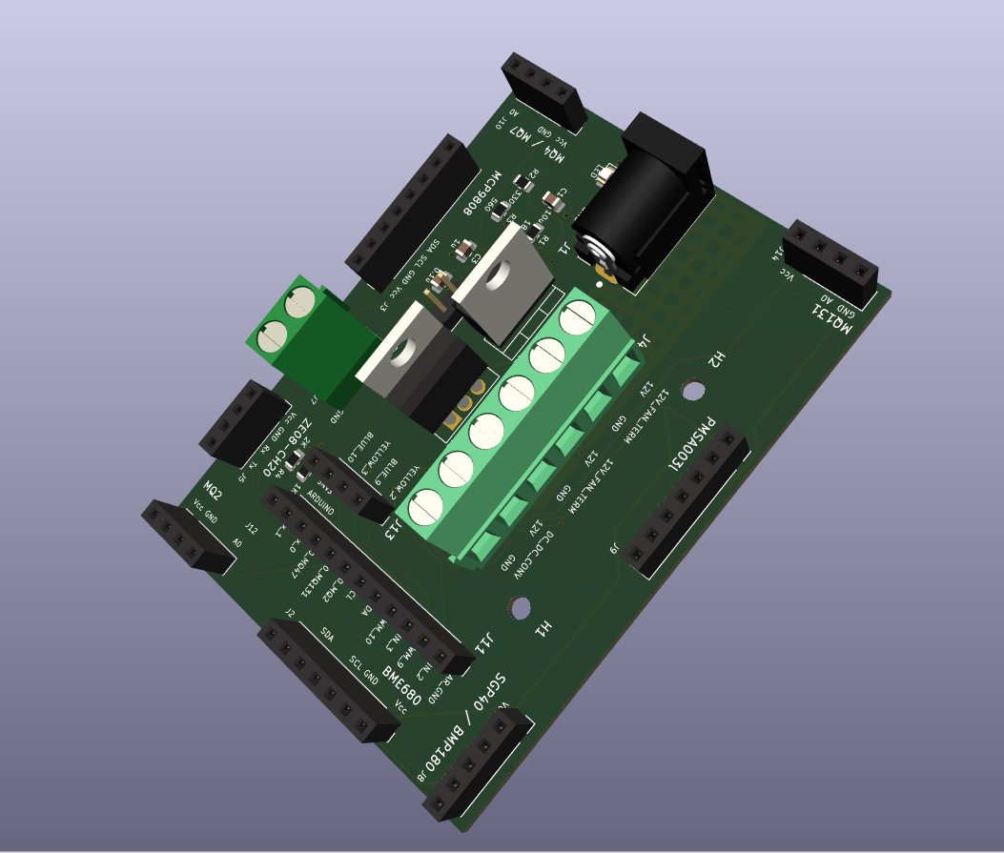
Custom PCB Design (2)

Slide 14
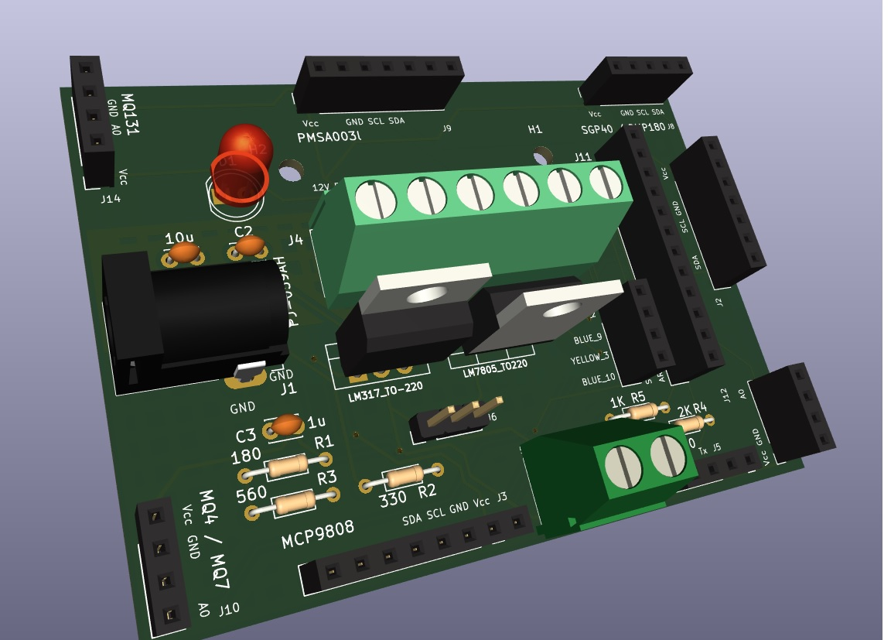
Custom PCB Design - Alternative (3)

Slide 15
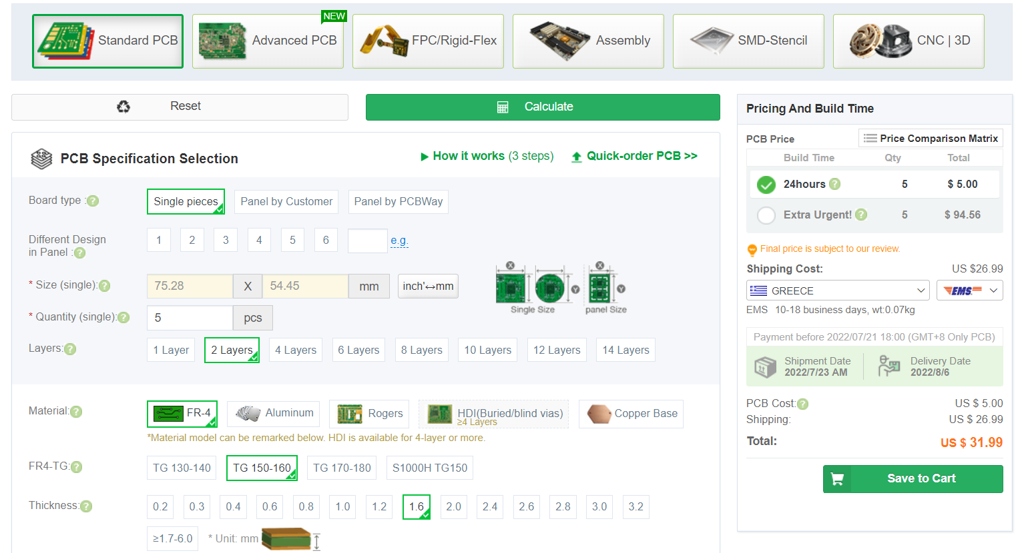
Online PCB Order
PCBWay

Slide 16
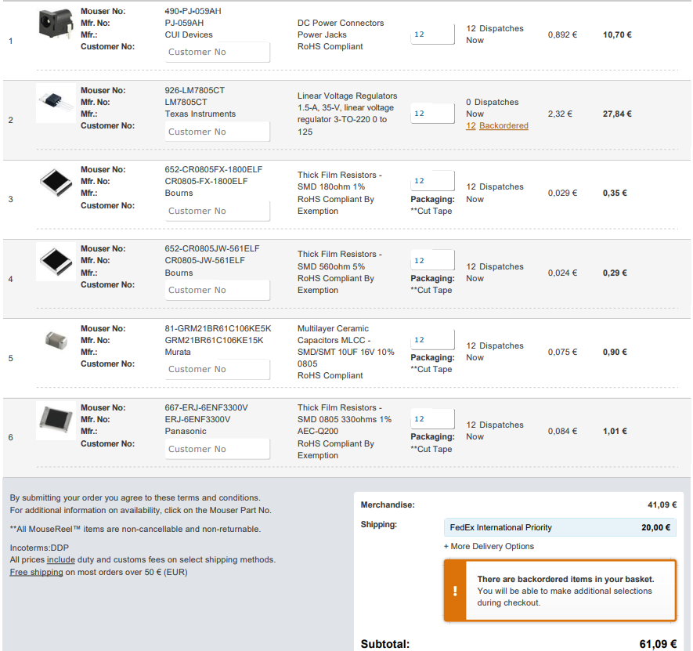
Online PCB Components Order (1)
Mauser Elec.

Slide 17
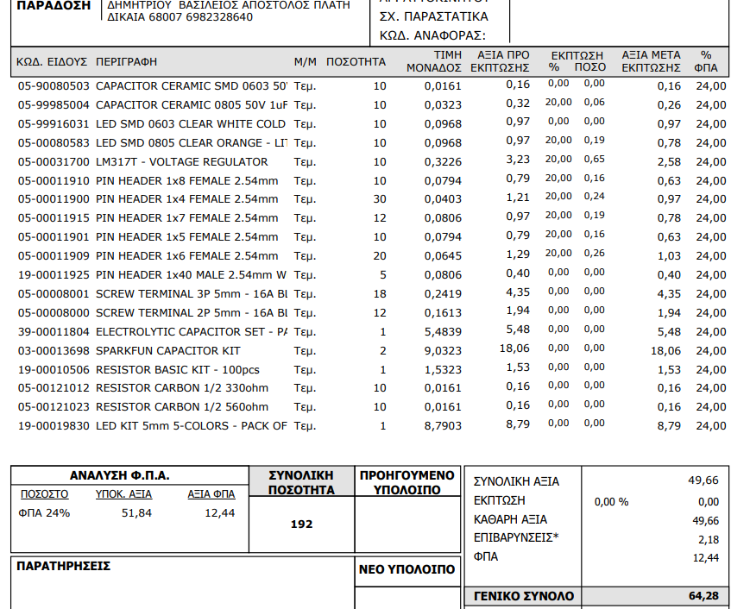
Online PCB Components Order (2)
Grobotronics

Slide 18
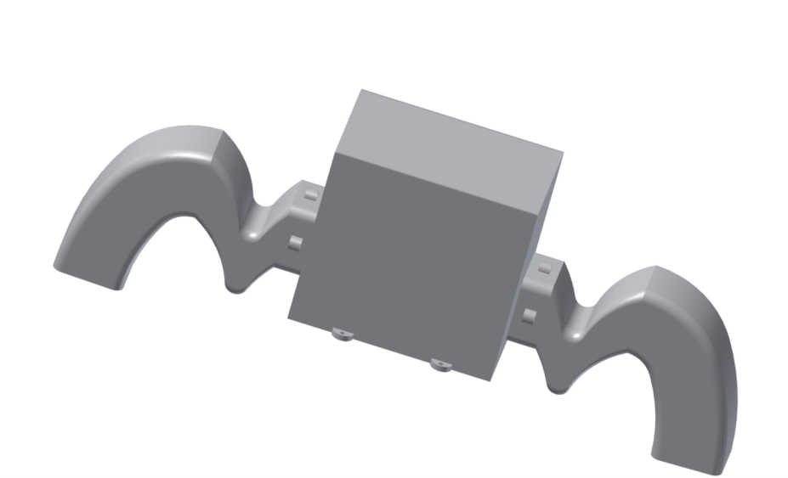
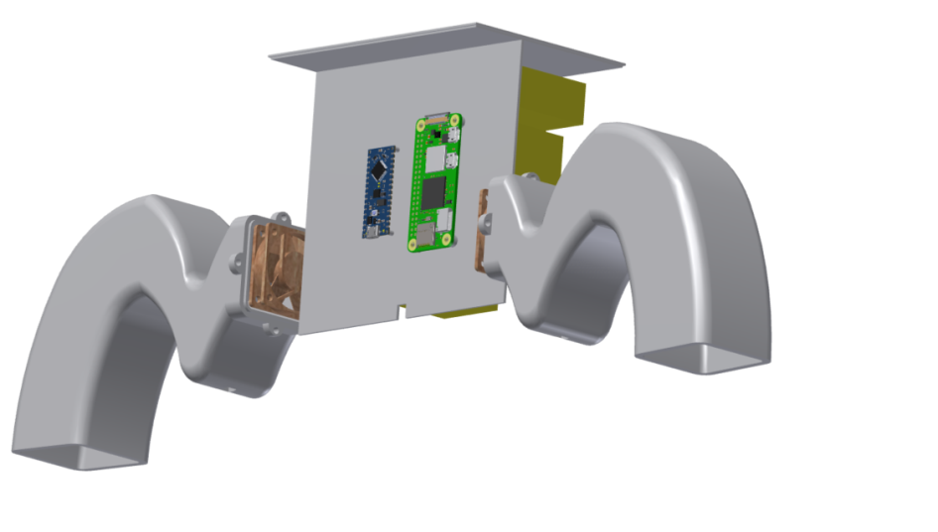
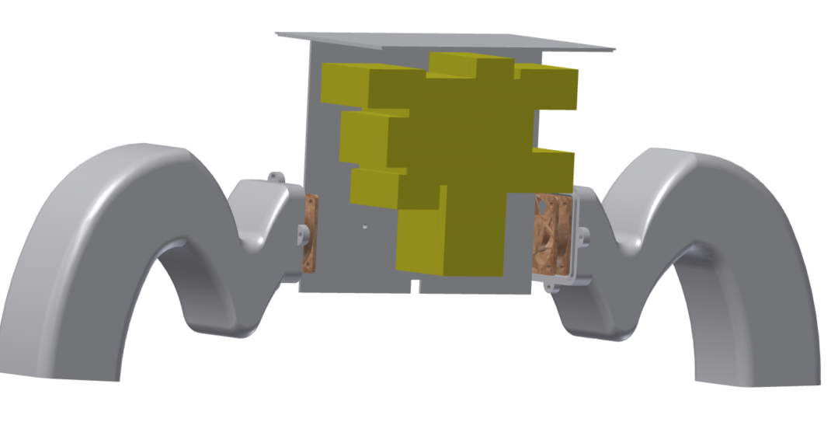
Arduino Box Enclosure (1)

Slide 19
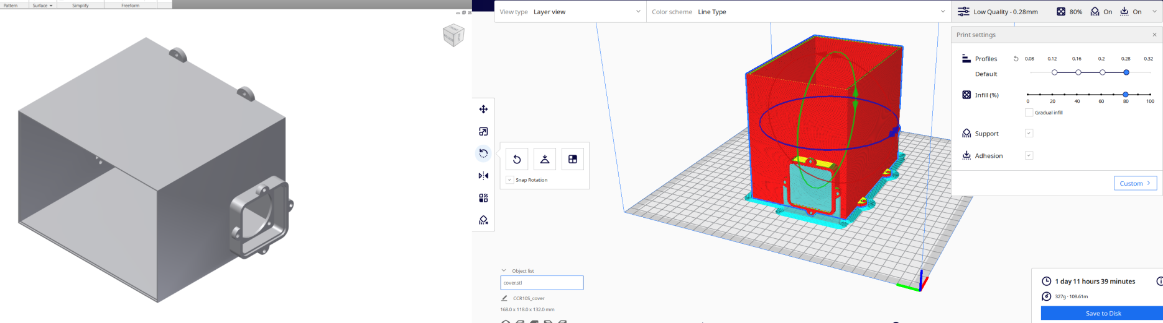
Arduino Box Enclosure (2)

Slide 20
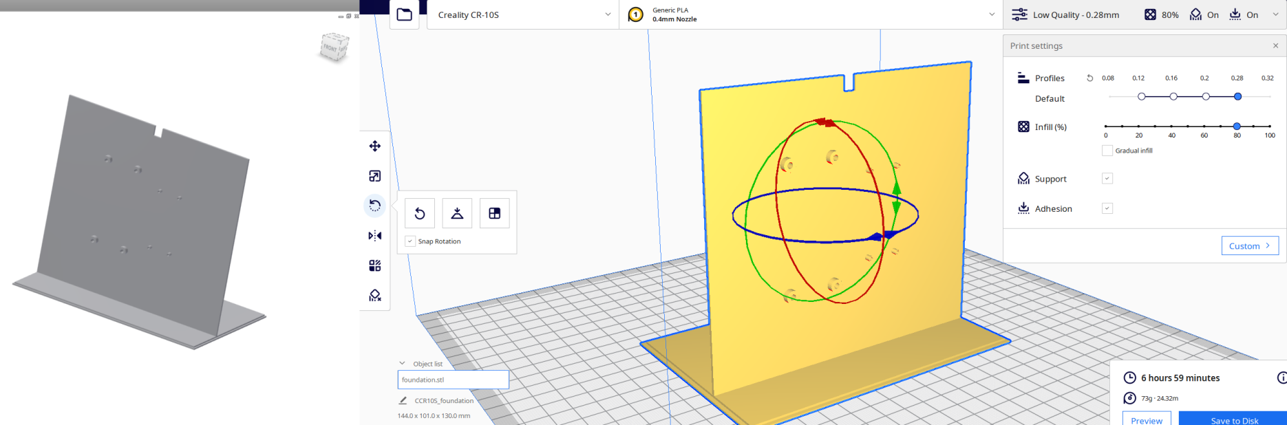
Arduino Box Enclosure (3)

Slide 21
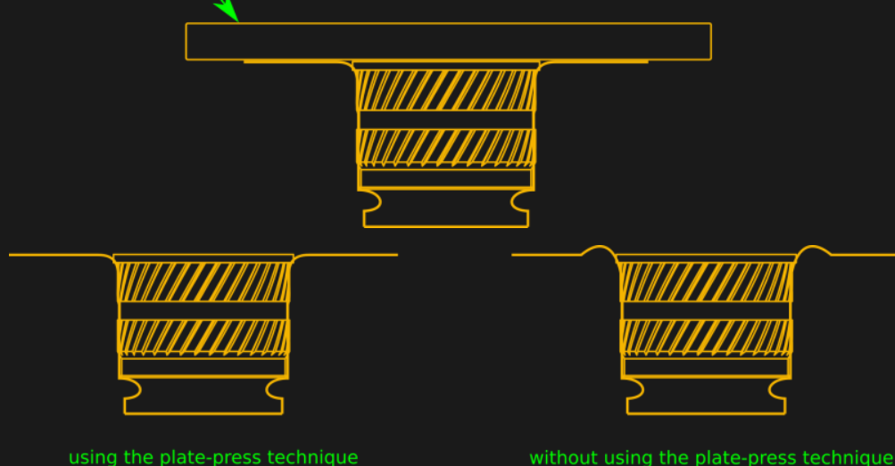
THERMOCOMPRESSED THREADED INSERTS FOR MOUNTING
Threading 3D Printed Parts: How To Use Heat-Set Inserts | Hackaday
Tokai Metal Industry Co.,Ltd:Insert Nut UD Ⅳ (tokai-mmc.co.jp)

Slide 22
Data Collection and Handling

Slide 23
Data Analysis (1)
Temperature , barometric pressure , humidity etc sensors :
“According to WMO (World Meteorological Organization), weather stations for measuring air temperature are the most commonly used devices with electrical resistance. The temperature is measured in an interval of a few seconds, from which then a 5-minute average is formed. At the full hour, these 5-minute funds are then aggregated to an hourly average. For non-automated - mostly private - stations, the measurement interval can also be one hour or even one day.” – Temperature, pressure, humidity
Frequentist Statistics : Confidence interval – the range of estimates for an unknown parameter
The same applies for the rest of the data derived from the sensing entities (VOC, NH3, CO2, CH2, Gasses, Dust)
Weather station for wind speed and direction:
(PDF) Technical note: Averaging wind speeds and directions (researchgate.net)
Frequentist Statistics : Confidence interval – the range of estimates for an unknown parameter

Slide 24
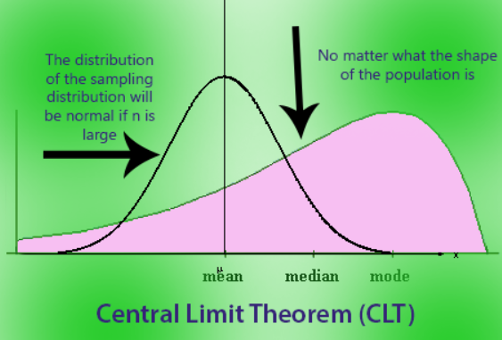
Data Analysis (2)
Sample mean is not enough to estimate the population mean. We need to know how good our population mean estimation is!
Considering that we have a population distribution X~N(μ,σ²),then X̄ distribution (sample mean) X̄ ~ N(μ,σ²/n) :
Confidence Interval (CI) : The sampling distribution mean - the estimate X̄ - has to abide by the statement: P(| X̄̄- μ| < d) = 1 – α
μ denotes the population mean
We make use of the Central Limit Theorem (CLT) for the sample mean

Slide 25

Data Analysis (3)
Df=n-1

Slide 26
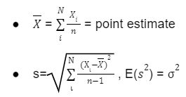
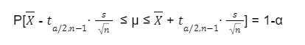
Data Analysis (4)
The interval approximates are sufficient when n is large (n≥30) , since the - observations distribution is unknown
Central Limit Theorem (CLT) entails that will be normal, even if the sample does not come from Normal Distribution
Mean and standard deviation of sample means : = μ &
Making use of the t – student distribution :

Slide 27
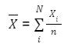
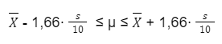
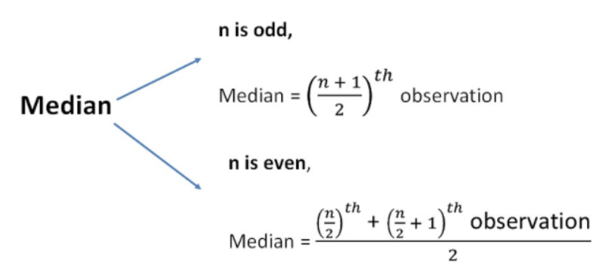
Data Analysis (5)
In our project, the following will be used :
Mean value of the sample
99% confidence interval for the unknown population mean (n>30)
Median value of the sample

Slide 28
Programming Using Raspberry

Slide 29
Programming (1) | Tools Overview
1. Data Collection
2. Data Storage and Processing
3. Server
Sensors to Arduino
Arduino IDE
Python + csv module
Data stored in a csv
Arduino to Rasp Pi
XAMPP APACHE Web Server
HTML and PHP on local IP
Usage of libraries and existing source code
Make modifications on the src code
0. Conjunction of Different Software
Arduino IDE
TXT Editor for src and h scripts
TXT for python scripts
XAMPP
TXT for PHP scripts
VM in the role of Rasperry Pi
Storing data in the MySQL database

Slide 30
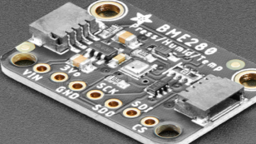
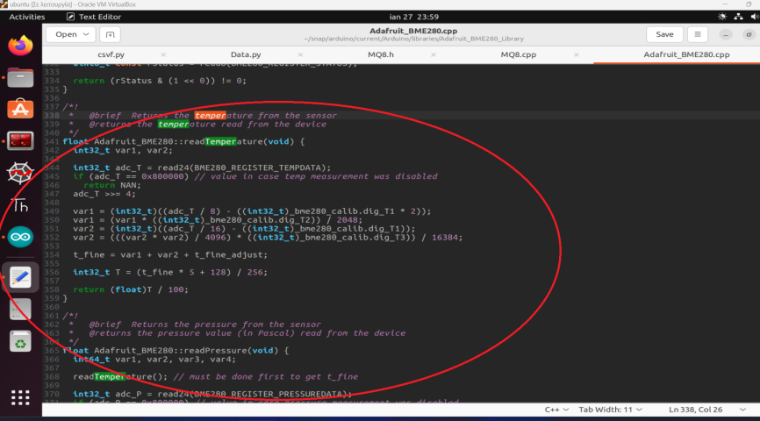
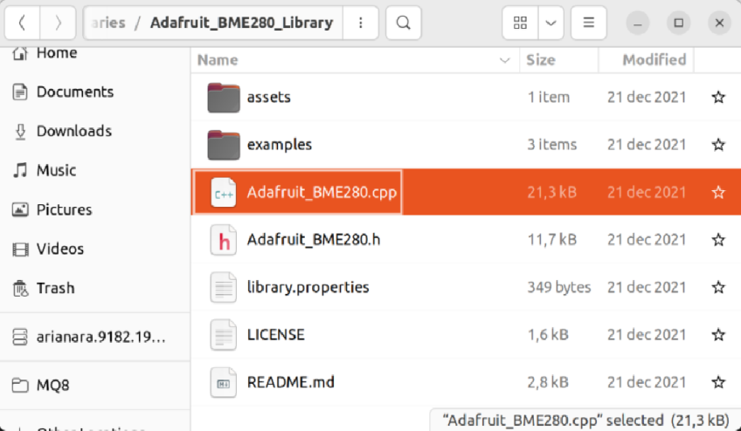
Programming (1) | Data Collection (1)
Sensor on Adafruit breakout
Adafruit src code – complicated!
I2C protocol
The output is:
Temperature [ºC]
Barometric Pressure [hPa=0,001bar]
Humidity [%]
BME280

Slide 31
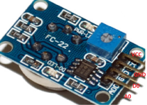
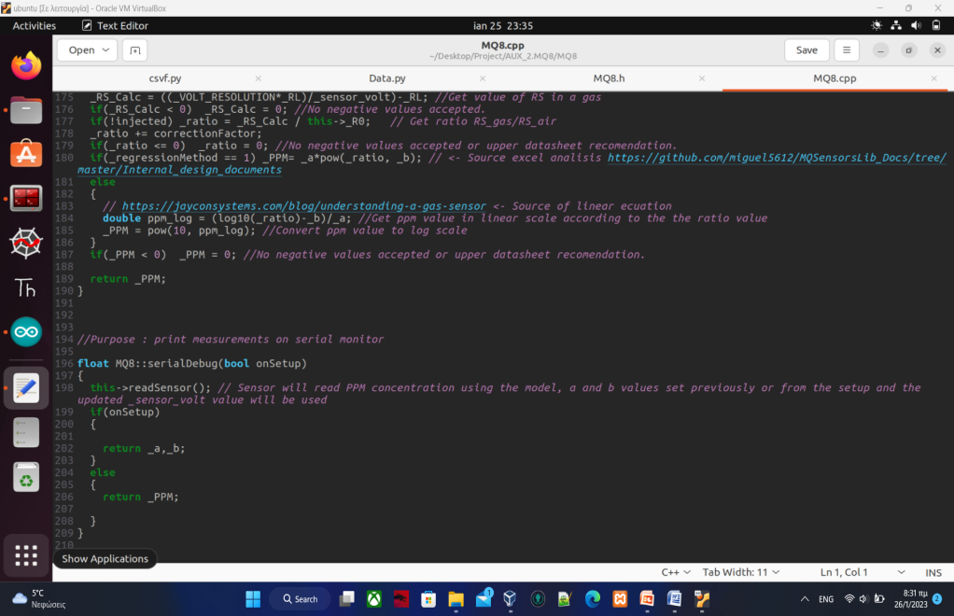
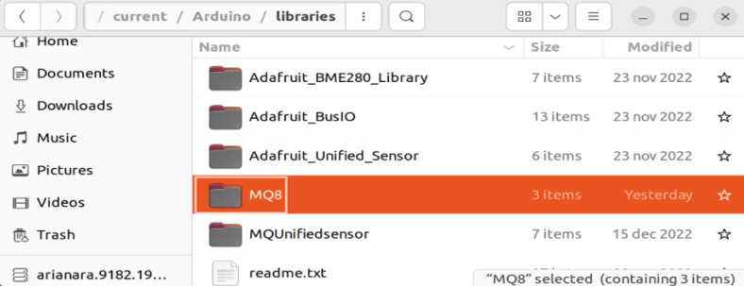
Programming (1) | Data Collection (2)
The output is H₂ in ppm!
Simplification and tweak of MQs’ source code
Create a common return method (object)
Calibration method has been checked
PPM Concentration = a x ratio^{b}
a=976,97 & b=-0,688 (this is being set on arduino script
Sensor analog output (A0) con. to analog arduino input
MQ8

Slide 32
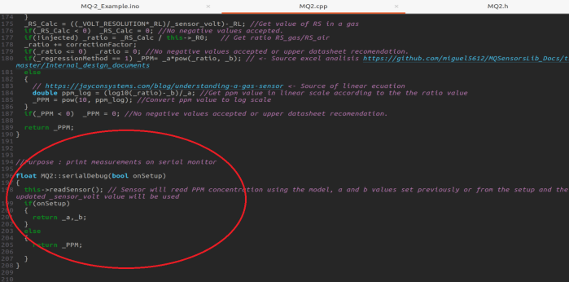
Programming (1) | Data Collection (3)
The output is LPG in ppm!
Simplification and tweak of MQs’ source code
Create a common return method (object)
Calibration method has been checked
PPM Concentration = a x ratio^{b}
a=574,25 & b=-2,222 (this is being set on arduino script
Sensor analog output (A1) con. to analog arduino input
MQ2

Slide 33
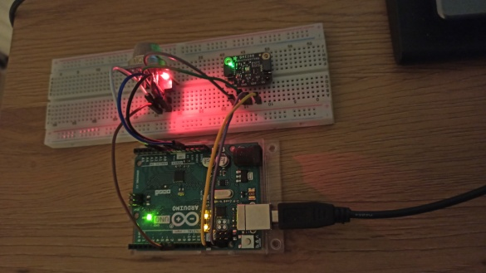
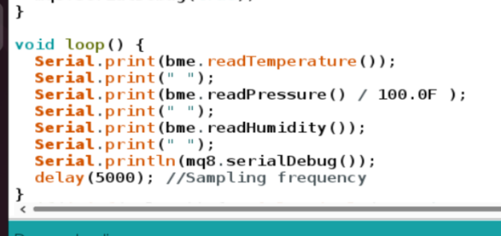
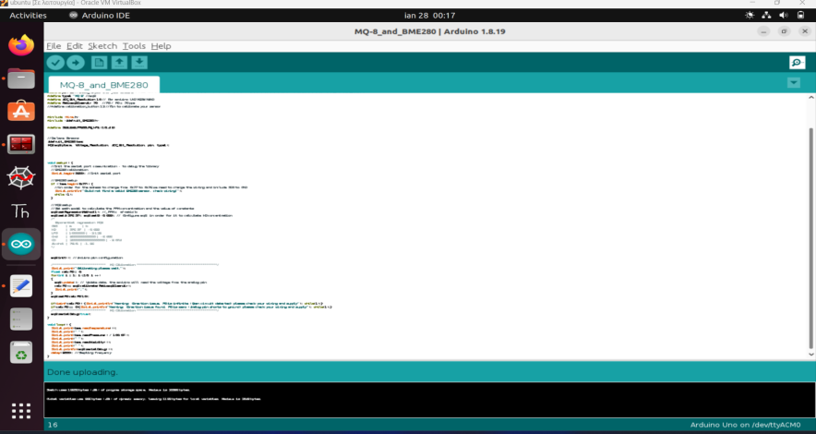
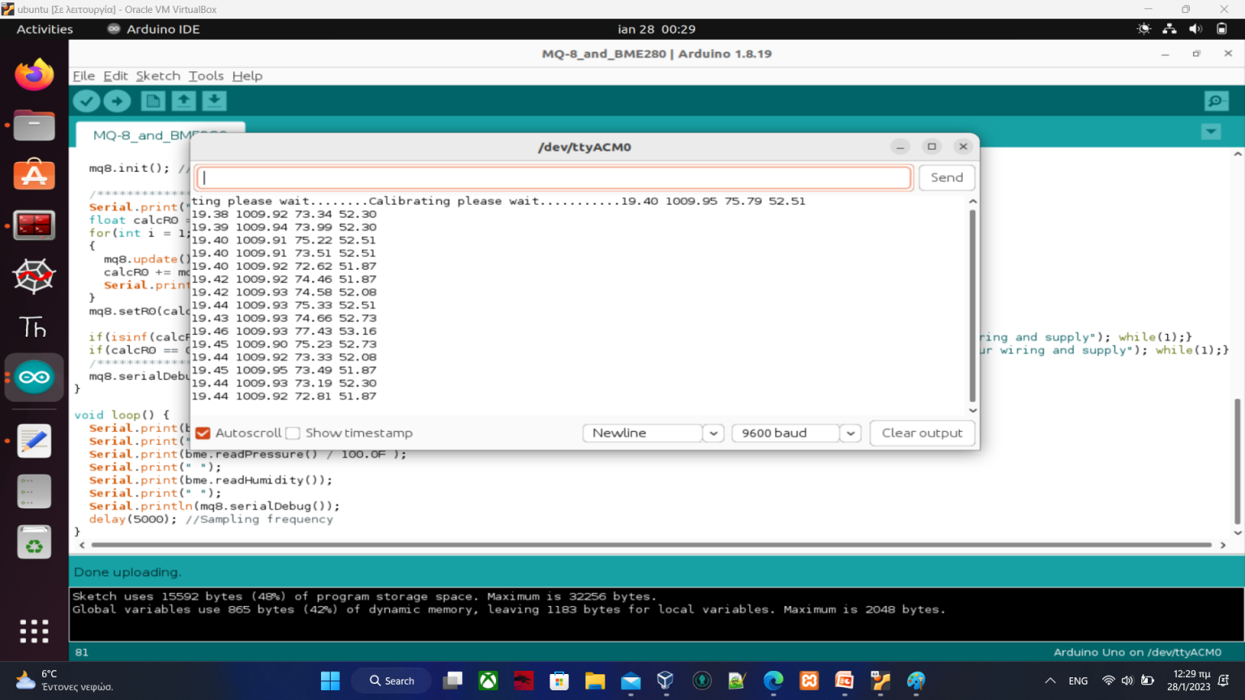
Programming (1) | Data Collection Example
2 Sensors at the same time leads to 4 columns:
Temperature | Bar Pressure | Humidity | H₂ Concentration
Note that the data is separated by a gap (Python script is to take advantage of this!)
BME280 + MQ8 breakout

Slide 34
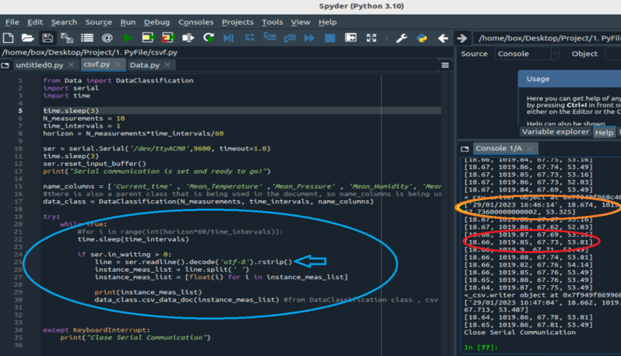
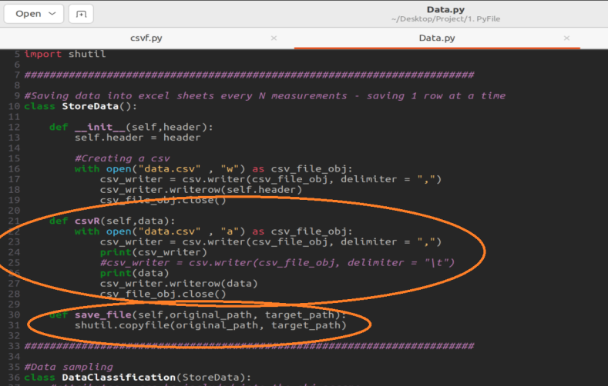
Programming (1) | Data Storage (1)
Python is being used to initialize the serial device making use of Serial class
We should not neglect to shut down the serial monitor of arduino IDE
One line can be read from the device
The data is getting split
The data is stored in an csv file
The csv file is getting updated in the “1. PyFile” folder
Then is being copied to the “2. link_PHP” folder in order not to disrupt the python code

Slide 35
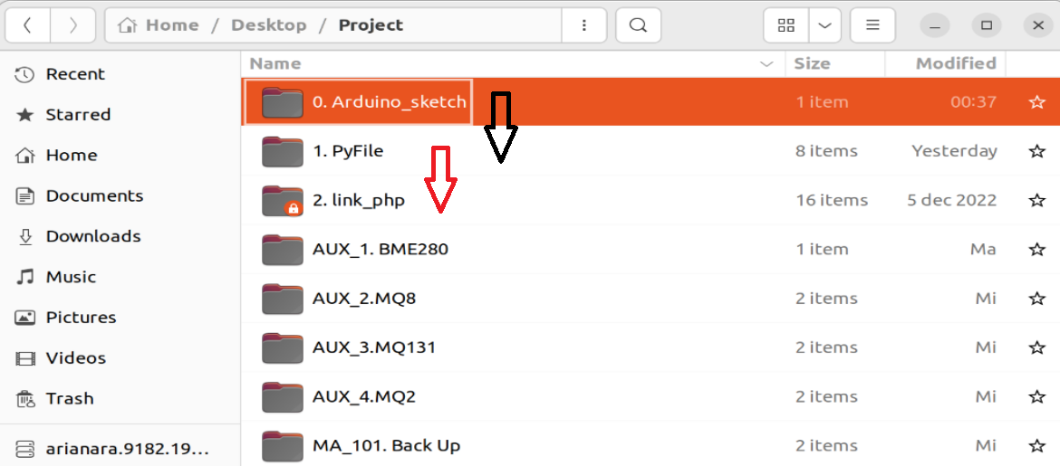
Programming (1) | Data Storage (2)
To Sum Up:
0. Arduino_sketch: sends data to serial port
1. Pyfile: takes the data from the serial port and store it in a csv file
2. link_php: the store csv file is getting copied to the shortcut file of the XAMPP location (requires some extra work – premissions are required in order to copy the file and create the shortcut file)

Slide 36
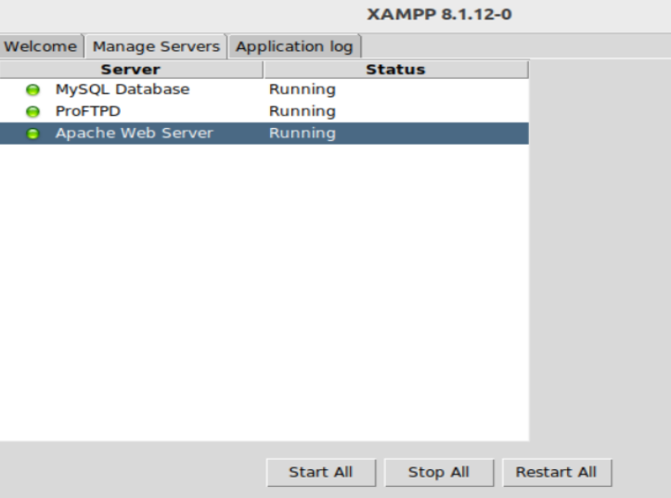
Programming (1) | Server (1)
XAMPP is needed in order to create a server
We need to program in PHP in order to make use of the data that have been saved in the XAMPP folder (data.csv)
Link_PHP → /opt/lampp/htdocs

Slide 37
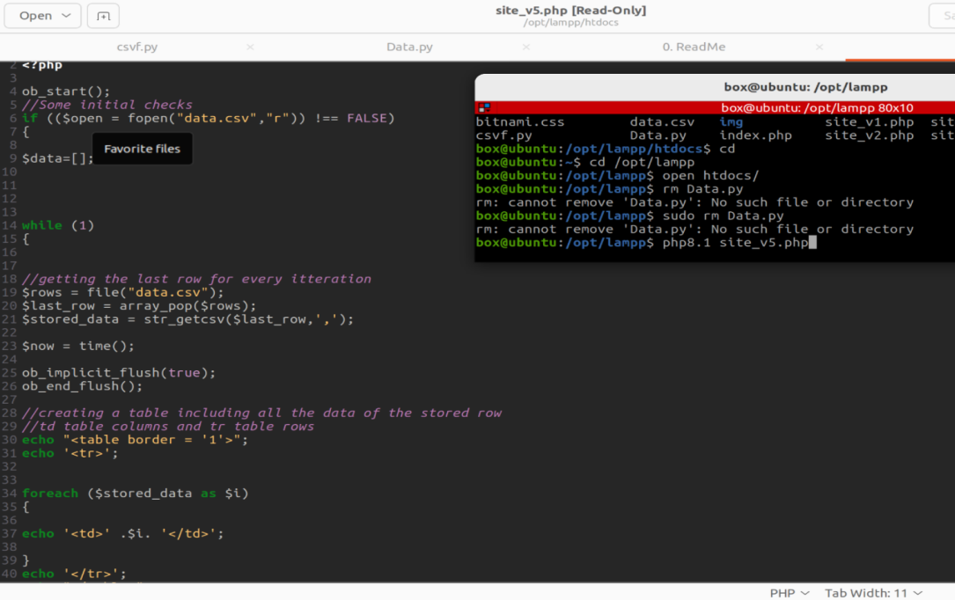
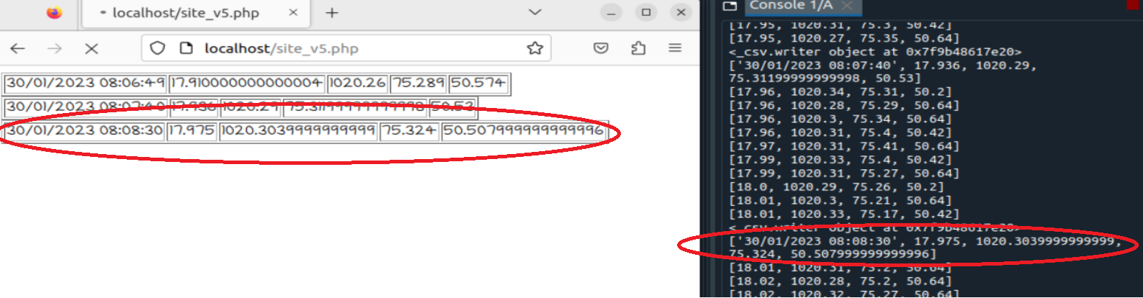
Programming (1) | Server (2)
Python to document storage time intervals = php time intervals = 60 seconds
After the arduino sketch and the python script have been run we need to run the php8.1 site_v5.php
This php script prints the data on the localhost – making use of Apache http of XAMPP

Slide 38
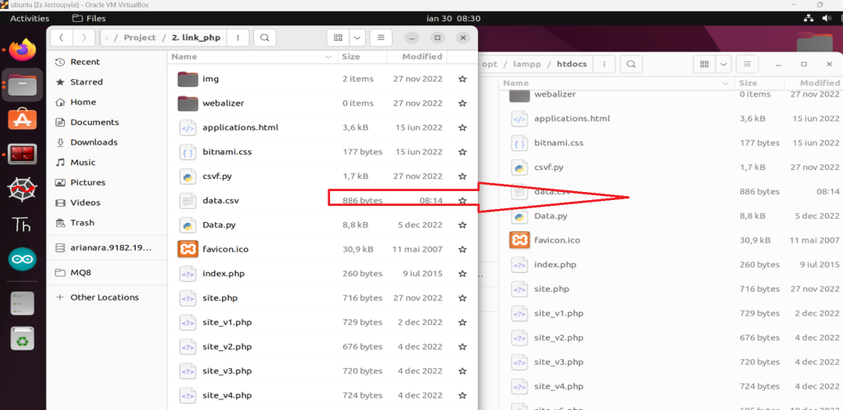
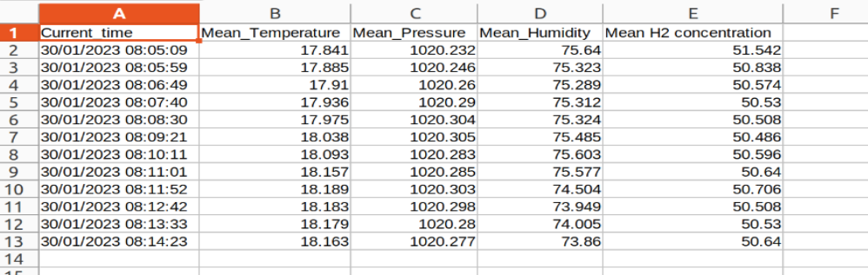
Programming (1) | Server (3)
Python script copies the data.csv to the server folder
The former file contains data as depicted bellow

Slide 39
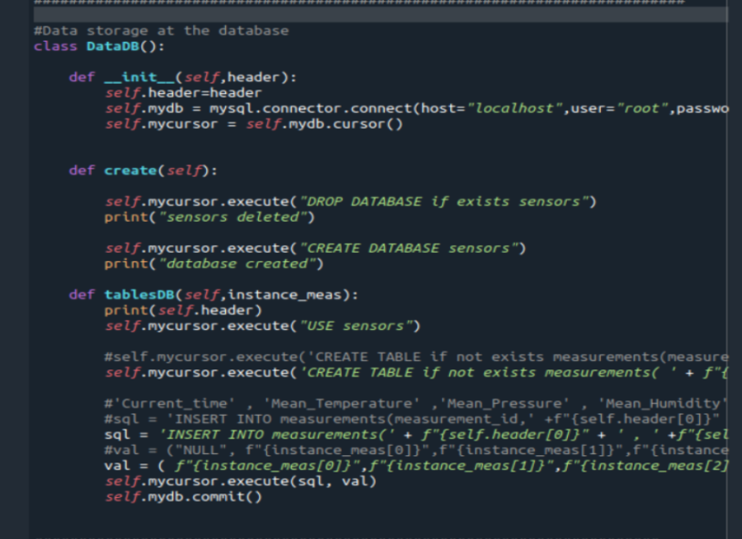
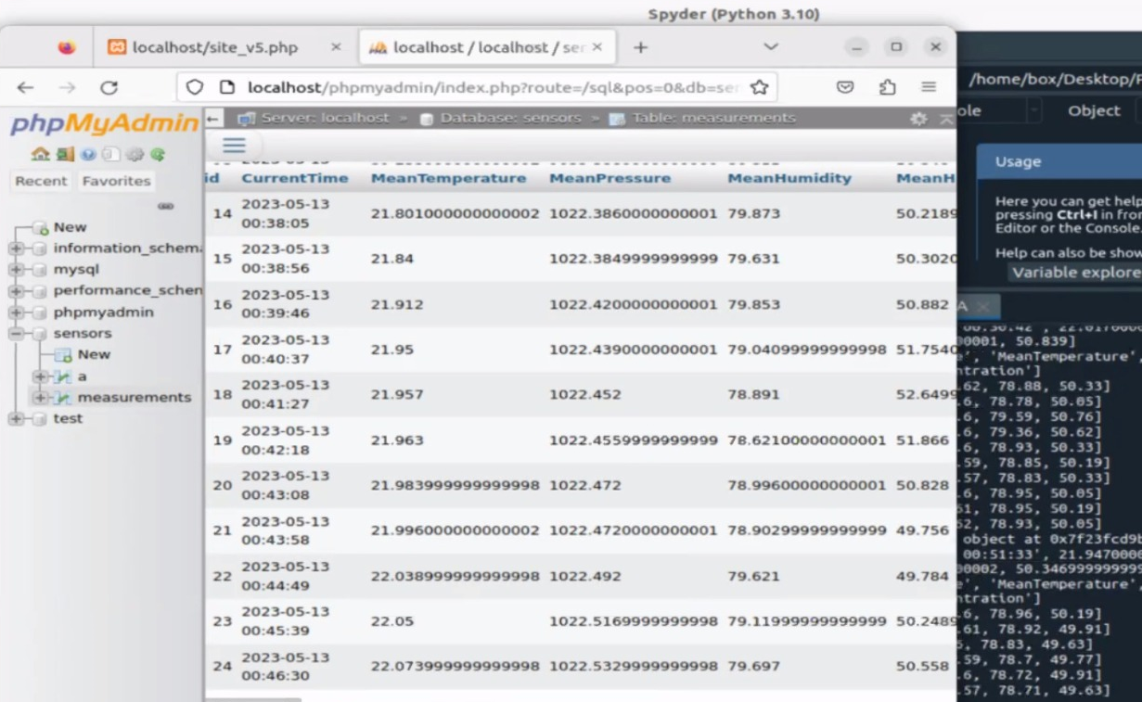
Programming (1) | Server (4)
Alternative to the previous practice is to store the collected data directly in the server
Creating a Web Server (MariaDB) in XAMPP and creating tables in this very server, utilizing MySQL connector in PYTHON
Same data are still being stored in the csv file

Slide 40
Programming Without Using Raspberry

Slide 41
Programming (2) | Tools Overview
0. Conjunction of Different Software
Sensors entities measuring physical quantities
Arduino deriving data from sensors
Arduino sending data to ESP8266 using UART communication
ESP8266 code calling a PHP script that stores data to a database
XAMPP
A PHP script that depicts data
1. Data Collection
Sensors to Arduino
Arduino IDE
Usage of libraries and existing source code
Usage of UART communication between the arduino and the ESP so as to Serial print the collected data
2. Data Receiving and Posting
Arduino to ESP8266
Arduino scripts that command the ESP8266 to read the data
3. Server
XAMPP APACHE Web Server
PHP on local IP
Storing data in the MySQL database
Usage of the ESP8266HTTPClient library so as to post data to the server
The data will be processed by a PHP file, after being posted by the Arduino skript <<String URL = "http://192.168.2.3/ KEDIAK_PROJECT/ store_data_and_database.php";>>
The PHP file uses SQL commands to stora data in the server table
The SQL command within the PHP file <<$sql = "INSERT INTO data_s (temperature, humidity , barpressure , H2Concentration) VALUES ('".$temperature."', '".$humidity."', '".$barpressure."', '".$H2Concentration."')";>>

Slide 42
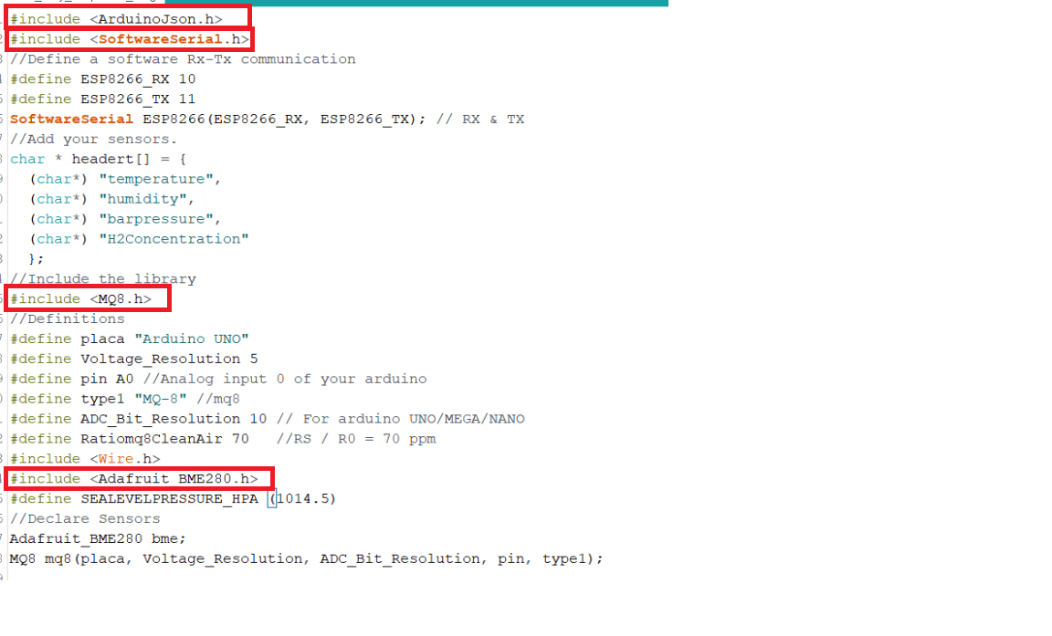
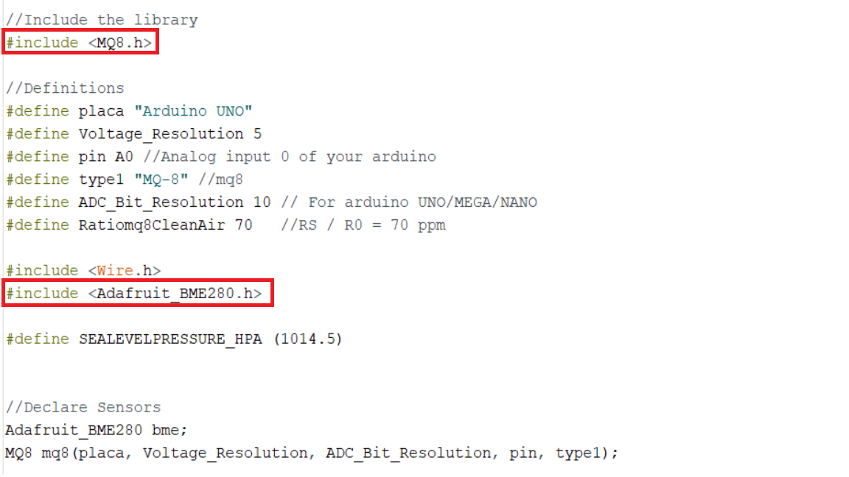
Programming (2) | Data Collection
Usage of the same source codes as in the previous set up (no difference between using and not using raspberry) – sensors measuring physical quantities.
Arduino prints the measurements I2C protocol.
Some memory issues arose!
The lack of memory has been alleviated by making use of the minimun quantity of libraries possible – excluded SoftwareSerial and ArduinoJson libraries (in the first instance the format of the sent message was JSON while in the second is a plain text).
Before: “no memory”
70% storage space
45% dynamic memory
After: running
52% storage sp.
30% dynamic mem.

Slide 43
Programming (2) | Data Receiving and Posting(1)
Data are being sent from the Arduino to the ESP8266.
The latter filters the received string – “message”. Measurements are being stored into some variables

Slide 44
Programming (2) | Data Receiving and Posting(2)
Web Server: Responsible for hosting and delivering websites or web applications. It handles HTTP requests from clients (web browsers) and sends the requested web pages or resources.
We use POST to create a new resource. A POST request requires a body in which you define the data of the entity to be created.
HTTP is a protocol, or a definite set of rules, for accessing resources on the web
The http.begin method refers to the following URL <<String URL = "http://192.168.2.3/ KEDIAK_PROJECT/store_data_and_database.php";>> , which constitutes the request destination and is stored in the database of the project

Slide 45
Programming (2) | Server(1)
Request to store data into the XAMPP server. $_POST[“measurement”], using data posted by the arduino sketch (http posting data -> http.POST( the datastring)
Usage of test_input function so as to filter the data
SQL commands that store data in a defined table within the database

Slide 46
Programming (2) | Server(2)
Data being stored into the database

Slide 47
Thank You !
The whole project is stored in different repositories on my github account:
github.com/Vasilisdi?tab=repositories

